Slide 1
ASSIST HEIDI · Co-Creation Project
Marua: Taking Pictures
and Videos
Wheelchair-mounted stabilizer with Bluetooth remote
for hands-free photography and video recording
Seagirls 🌊 · Natálie · Alina · Markéta
Est. cost: ~€90 · MIT / CC BY 4.0

Slide 2
The Problem that needed solution
Who is Marua and what did she need?
Marua, 30 — Wheelchair User
Her Request
Diagnosis: Myoclonic Epilepsy
Goal: Take stable photos & videos — including while moving The solution needed to:
Primary impairment: Uncontrollable tremors and twitching of the hands Remaining abilities: Can press large buttons even with limited fine motor control Cognition: Fully capable, communicates without difficulty
Mount phone to wheelchair frame
Stabilize phone independently of hand movements
Trigger shutter without touching phone
Switch between photo and video mode
Work while wheelchair is in motion
Seagirls 🌊 | ASSIST HEIDI

Slide 3
The Solution
Two-part assistive technology device
Part 1 — Smartphone Stabilizer
Part 2 — Bluetooth Remote
Loc-Line arm (3/4")
Adafruit Feather V4
Flexible modular hose — holds phone at any angle
BLE + LiPo charging built-in, USB-C
Magnetic phone adapter
LiPo battery (3.7V 800mAh)
Quick attach/detach — works with any smartphone
Rechargeable, JST connector
Wheelchair clamp
3D-printed enclosure
Screw-tightening — fits any standard wheelchair frame
Openable — easy component swap, PLA ~3.5h print
Seagirls 🌊 | ASSIST HEIDI

Slide 4
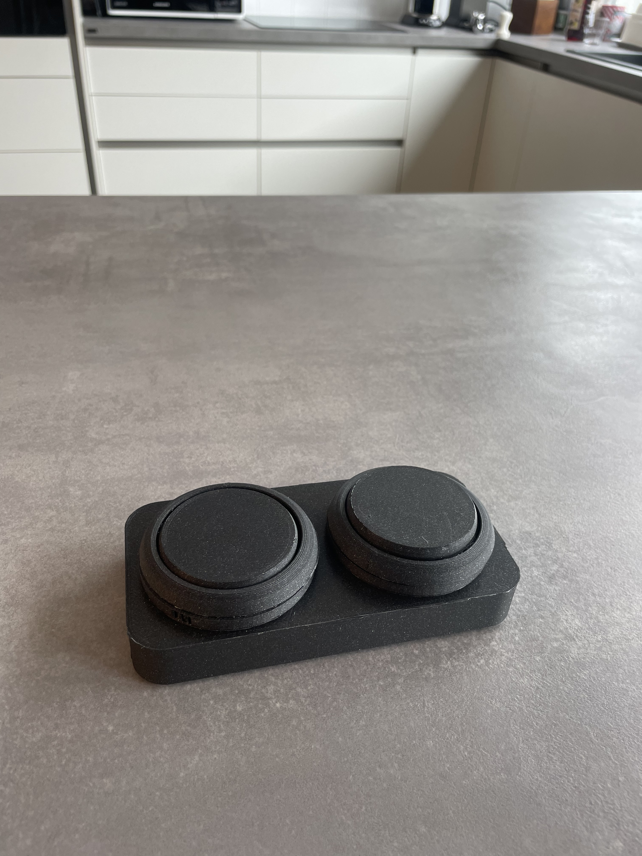
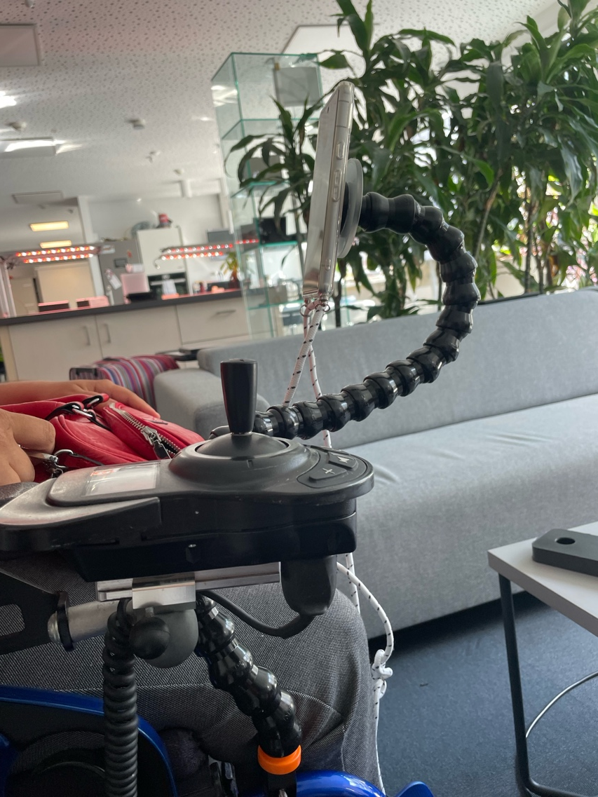
The Solution
Two-part assistive technology device
Part 1 — Smartphone Stabilizer
Part 2 — Bluetooth Remote
Seagirls 🌊 | ASSIST HEIDI

Slide 5
How It Works
Setup & controls at a glance
Setup — 5 Steps
🎮 Controls
1
Clamp Loc-Line arm to wheelchair frame
Button 1
— Shutter
take photo
start/stop video
2
Attach magnetic adapter to arm end
3
Stick magnetic sticker on phone, attach phone
Button 2
— Mode
front camera↔rear camera
4
Turn on remote, pair via Bluetooth
5
Open camera app → use remote
Bluetooth HID · C++ · VS Code
Seagirls 🌊 | ASSIST HEIDI

Slide 6
Technical Overview & Cost
Reproducible by anyone with a 3D printer
Key Specs
3D Print
PLA · Prusa MK4S · ~3.5h
CAD
Onshape (open link in docs)
Firmware
C++ · Bluetooth HID · VS Code
MCU
Adafruit Feather V4 (BLE + LiPo)
Weight
Lightweight — no added strain
License
MIT (code) · CC BY 4.0 (docs)
Tools needed: 3D printer · Soldering iron · USB-C cable · PrusaSlicer · VS Code
Seagirls 🌊 | ASSIST HEIDI

Slide 7
Lessons Learned
What worked, what we'd do differently
What went well
Improvement suggestions
Key takeaway
Loc-Line arm is extremely flexible and stable — perfect for this use case.
Bluetooth HID approach worked without any custom app on the phone.
Magnetic phone adapter made mounting effortless.
Switching between photo mode and camera
Improvement of stability
Would add a charging indicator LED next version
Involve the user at every step — Marua's feedback shaped the final button size and placement critically.
Simple solutions beat complex ones in AT design.
Seagirls 🌊 | ASSIST HEIDI

Slide 8
Thank You!
Questions?
Seagirls 🌊 · Natálie · Alina · Markéta

